Slide 1
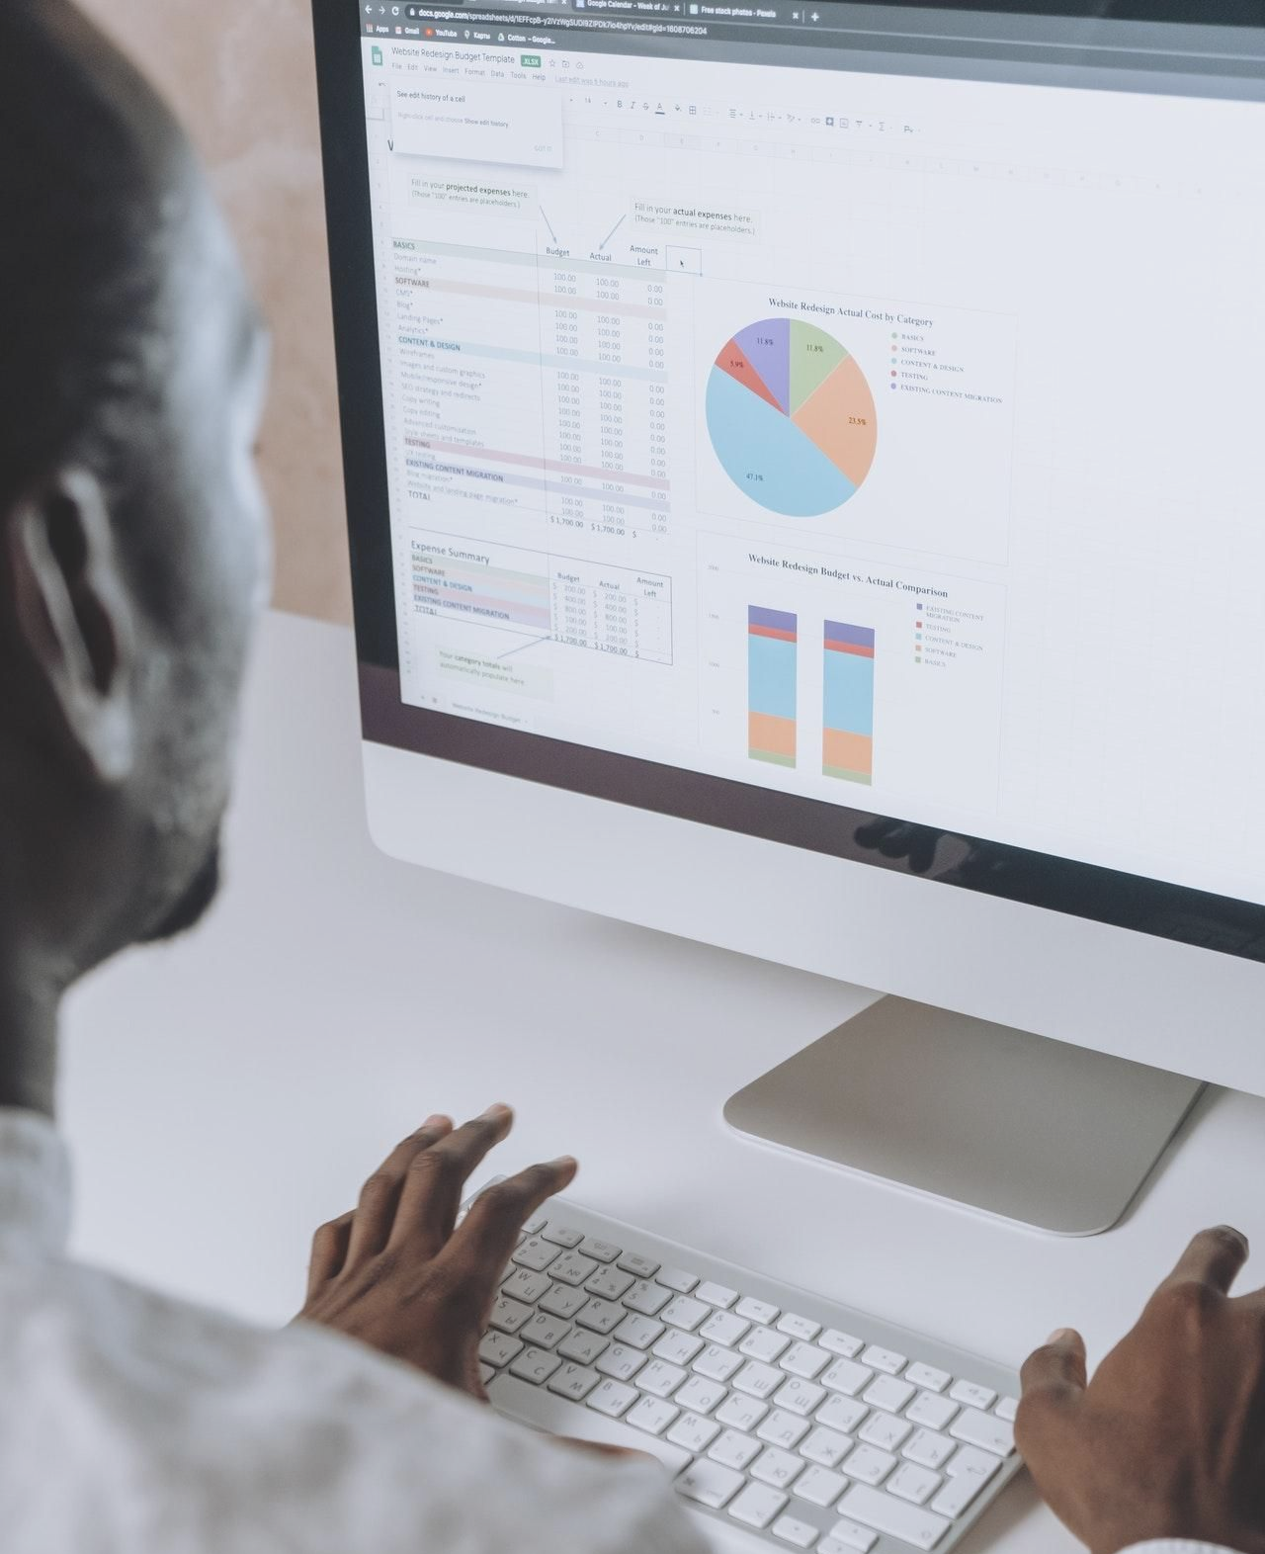

Tableau Projet Template
1

Slide 2

Tableau-Project 1
Matteucci Cyril
Date: Jully 28, 2021

Slide 3
Introduction
Who i am?
I’am Matteucci Cyril.
Sometimes credit risk is the possibility of a loss resulting from a borrower's default to repay a loan or to meet his contractual obligations. Like Tradition, it refers to the risk that a lender will not receive principal and interest due, resulting in disruption of cash flow and increased collection costs.
Our client faced this problem and contacted us to analyze and bring solutions to his problem.

Slide 4
The problem
This problem is important for the client because the unsecured loan can bankrupt the business and even break the business.

Slide 5
Methodology
1) Plot the appropriate charts for the variables
2)Create worksheets with the charts
3) Create a final attractive Dashboard with the worksheets

Slide 6
Discussion & proposal solution
Solution:
further facilitate people with good loans already and do a credit training for those who do not have loans so that they can know more about it and what they can get as an advantage

Slide 7
Alternative solution:
We give loans to people according to their salary so that the loan does not bother people too much.

Slide 8
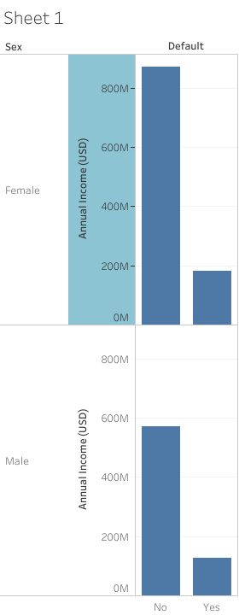
From this observation we can see that the wages of women salary is higher than those of men. the female salary is 80M while the male salary is less than ,60M,and this influenced because there are more women who make a lot more loans than men and women's loans are more expensive

Slide 9
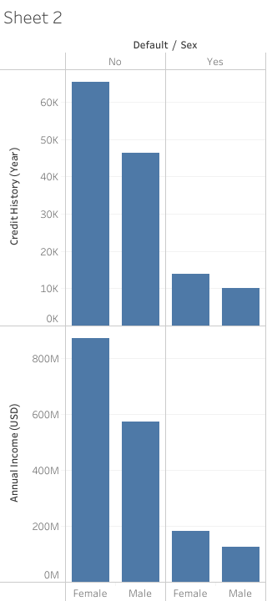
tFrom this observation, we can see the potential possibility of having risks depending on income with the years in which the loans were made

Slide 10
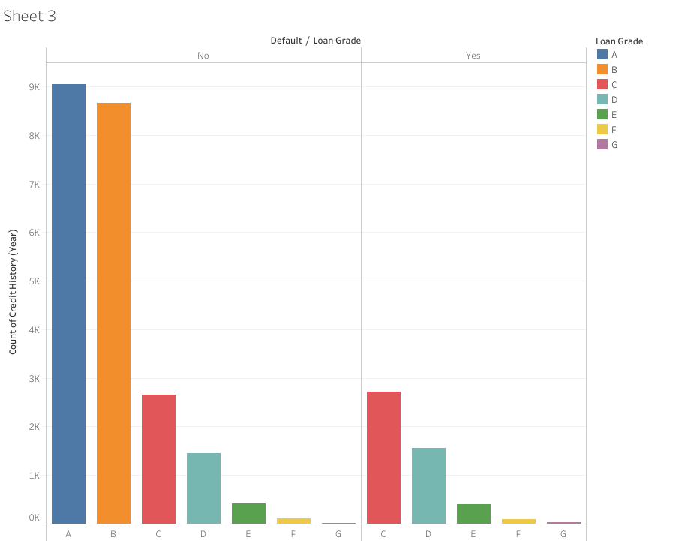
This graph allows us to visualize the number of years that this loan has been held and whether there is a risk or not on the loan so that the person does not pay.

Slide 11
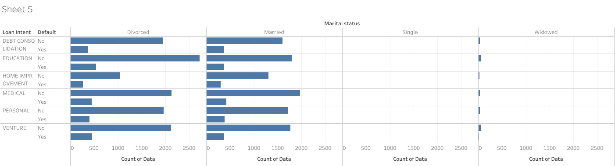
This graph allows us to do a study of the marital status of people and look at all the marital statuses that are most likely to repay the loan.

Slide 12
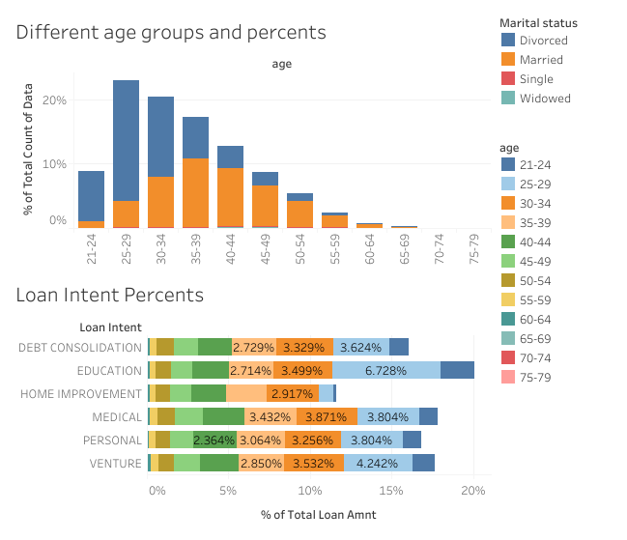

Slide 13
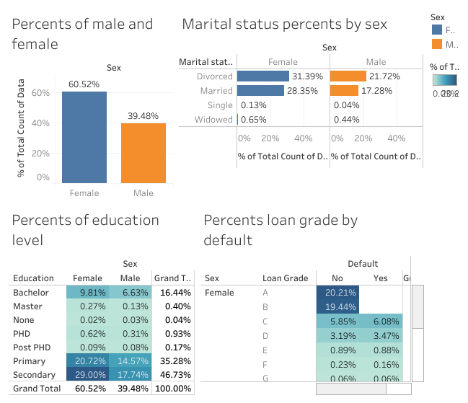

Slide 14

Appendix
What resources can the audience use to further understand the message and story being presented?
For further informations, please visit:https://github.com/engy06/Tableau.git

Slide 15
Prepared by :Matteucci Cyril

